Slide 1


CYBR644 – Cyber Practitioner Lab
Spring 2024
University of Maryland, Baltimore County
Michael Hennick

Slide 2
Discord Reminder
This class uses a Discord Server to facilitate “classroom discussion” during lecture and between classes
Please follow the link below to join the server and I’ll add everyone to the role for this semester’s class.
You can also request a “private” channel for your group so you can work and share information “amongst yourselves” and not on the classroom wide “general” channel.
https://Lairnet.link/Discord

Slide 3
Review
Know the Security Triad elements.
Be familiar with the elements of risk.
Describe the modes of ethical hacking.
Be familiar with the different types of security tests.
Describe the difference between hackers, crackers, and ethical hackers.
Be familiar with test phases of ethical hacking.
Know the laws and regulation governing cybercrimes.
What is Ethical Hacking and why do we do it?
Understand key command line tools and what the information tells you in each “Cyber Security” perspective
1. IPCONFIG/IFCONFIG
2. PING
3. NETSTAT
4. ARP
5. TRACEROUTE/TRACERT
6. NET [USE, VIEW, etc]

Slide 4
Overview of the course
Week 01 – Introduction, Ethical Hacking Basics, Ethics, Law
Week 02 – Technical Foundations of Hacking
Week 03 – Reconnaissance, Social Media
Week 04 – Scanning and Probing
Week 05 – Vulnerability Identification
Week 06 – Exploiting Weaknesses
Week 07 – Class Presentations / Review for Exam
Week 08 – Spring Break
Week 09 – Midterm Exam
Week 10 – Privilege Escalation, Maintaining Access
Week 11 – Malware, Covering your Tracks
Week 12 – The Web
Week 13 – Wireless and Mobile Security
Week 14 – Physical Security, Social Engineering, and Security Policies
Week 15 – Class Presentations / Review for Exam
Week 16 – Final Exam

Slide 5
Attacker’s Methodology
Attackers follow a fixed methodology that can be divided into six steps:
Performing reconnaissance
Scanning and enumeration
Gaining access
Escalation of privilege
Maintaining access
Covering tracks and placing backdoors

Slide 6
Reconnaissance and Footprinting
The first pre-attack phase
Systematic attempt to collect as much information about the target as possible:
PASSIVE information gathering
Reconnaissance techniques:
Dumpster diving
Social engineering
Internet research

Slide 7
Scanning and Enumeration
Second pre-attack phase.
Scanning is actively trying to connect to the system and get a response and identify open ports.
Enumeration is in-depth information gathering about the target:
Open shares
User accounts information
Software versions
Considered ACTIVE information gathering.

Slide 8
Gaining Access
The attacker moves from probing the network to attacking it.
Access can be gained using a variety of techniques:
Open wireless connection
Unsecured system
System vulnerability
Web applications vulnerabilities
Backdoors
Using social engineering techniques to get network access information

Slide 9
Escalation of Privilege
Attackers try to gain administrative access by escalating their privilege.
By exploiting a vulnerability or a bug in the system or an application
After the privilege escalation attackers have full control over the system and network.

Slide 10
Maintaining Access
Attackers use various techniques to maintain access to the system:
Stealing additional passwords
Placing rootkits
Using sniffers

Slide 11
Covering Tracks
Attacker try to erase all evidence from their activities:
Modifying log files to cover tracks
Hiding files and folders
Using Alternate Data Streams (ADS)
Using rootkits
A backdoor could be used for gaining access to the system again.

Slide 12
Attack Methodology
Reconnaissance/Open Source Intelligence
What network space does a target use?
What does the internet know about a target?
What information about my target is in social media sites?
2. Scanning and Enumeration
What hosts are online within a target’s network space?
What protocols are the hosts using?
What Operating Systems/Applications are running?
(2.5. Vulnerability Identification)
What is potentially exploitable on these target systems?
What are means for attack for this target?
3. Gaining Access/Exploitation
Exploiting the vulnerabilities to get access to the target, or taking advantage of other weaknesses
4. Escalation of Privilege
Exploiting the vulnerabilities to get access to the target
5. Maintaining Access/Exfiltration of Data
Create a legitimate method of accessing the system
“Smash-and-grab”
6. Cover Tracks
Removing log files/history

Slide 13
The Ethical Hacker’s Process
Follows a similar process as the attacker.
Strives to do no harm.
The goal is to assess the organization’s strengths and weaknesses and develop a security methodology.
Five steps in security methodology:
Assessment
Policy development
Implementation
Training
Auditing

Slide 14
Additional Methodologies
NIST 800-115 (Information Security Testing & Assessment)
Operational Critical Threats, Assets, and Vulnerability Evaluation (OCTAVE)
Open Source Security Testing Methodology Manual (OSSTMM)
Penetration Testing Execution Standard (PTES)
Penetration Testing Framework (PTF)
And more…..

Slide 15

OSI Model
Describes the flow of communications in a network environment
Seven layers
Application
Presentation
Session
Transport
Network
Data link
Physical

Slide 16
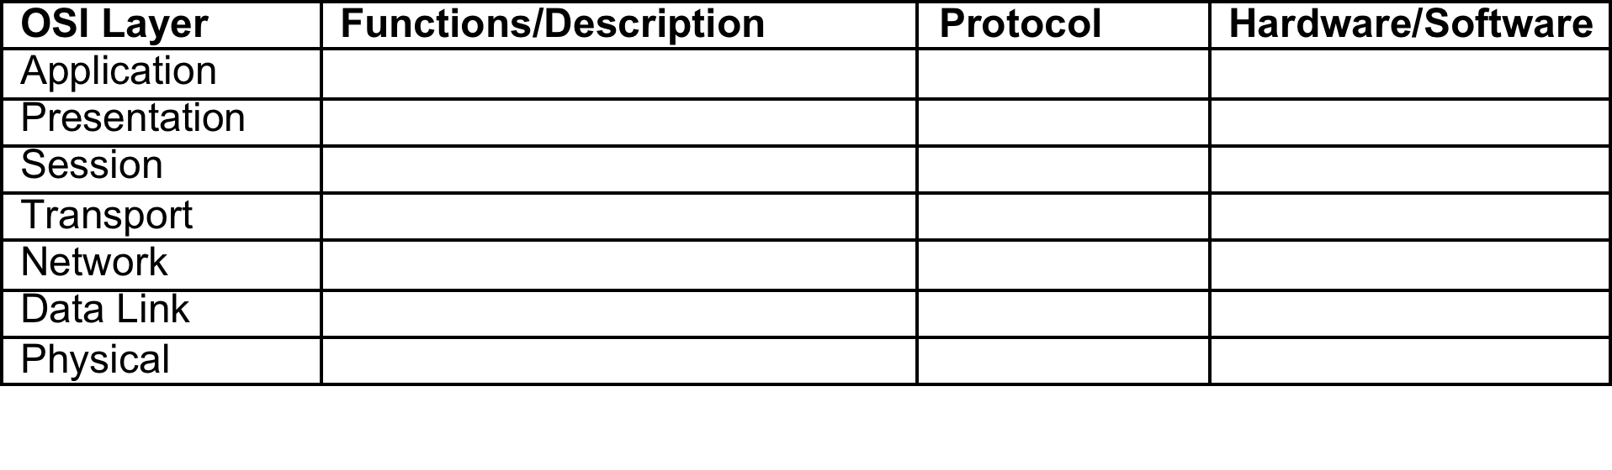
OSI Model

Slide 17
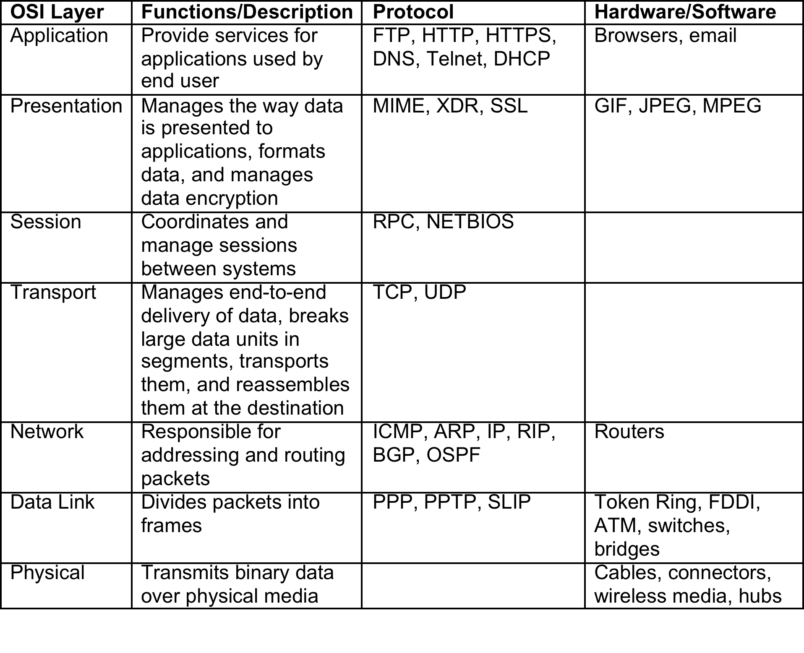
OSI Model

Slide 18
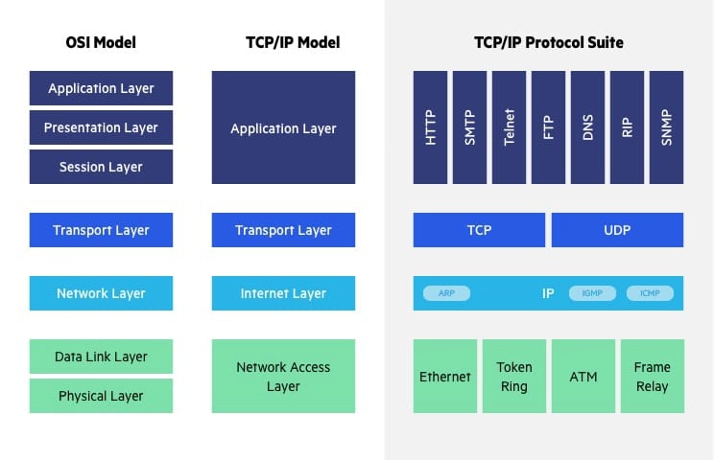
OSI vs TCP/IP Model

Slide 19
TCP/IP Protocol Model
The standard for Internet and network communications
Consists of four layers:
Application (7,6,5)
Host-to-host (4)
Internet (3)
Network access (2,1)
Contains multiple protocols but there are four main ones:
Internet Protocol (IP)
Transmission Control Protocol (TCP)
User Datagram Protocol (UDP)
Internet Control Message Protocol (ICMP)

Slide 20
Application (7,6,5) Layer
Responsible for application support
Protocols:
File Transfer Protocol (FTP)
Telnet
Simple Mail Transfer Protocol (SMTP)
Domain Name Service (DNS)
Trivial File Transfer Protocol (TFTP)
Hypertext Transfer Protocol (HTTP)
Simple Network Management Protocol (SNMP)

Slide 21
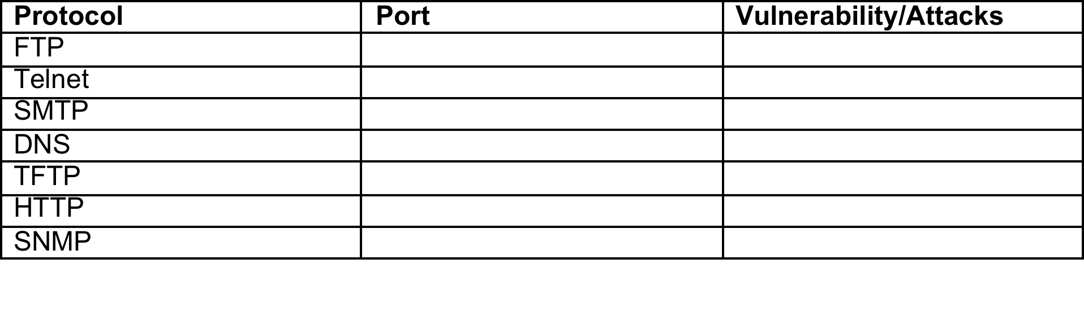
Application (7,6,5) Layer

Slide 22
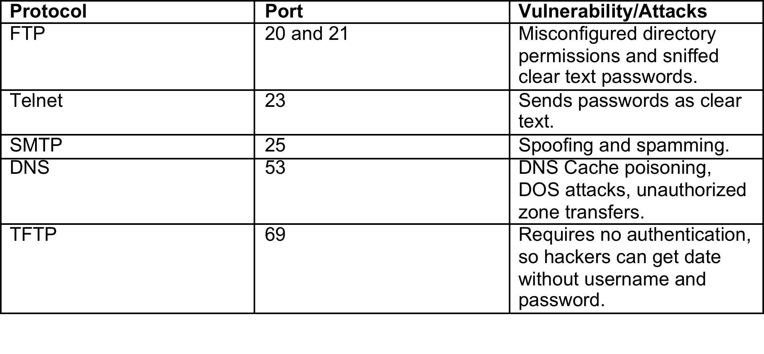
Application (7,6,5) Layer

Slide 23
Host–to–Host / Transport (4) Layer
Provides end-to-end delivery
Two primary protocols located at this layer:
Transmission Control Protocol (TCP)
Transports data to another host
Connection-oriented: reliable delivery
Performs three-step handshake
User Datagram Protocol (UDP)
Fast but does not guarantee delivery of the packets
Does not use a handshake process

Slide 24
Internet / Network (3) Layer
Contains the following protocols:
Internet Protocol (IP):
Provides source and destination addressing
Responsible for datagram fragmentation
Routable
Internet Control Message Protocol (ICMP):
Provides error and control messages
Used by Ping utility
Address resolution protocol (ARP):
Resolves IP to MAC addresses

Slide 25
Network Access (2,1) Layer
Responsible for physical delivery of IP packets via frames
Ethernet frames use MAC addresses for identification:
A physical address that uniquely identifies a particular NIC
Could be
Unicast
Multicast
Broadcast

Slide 26
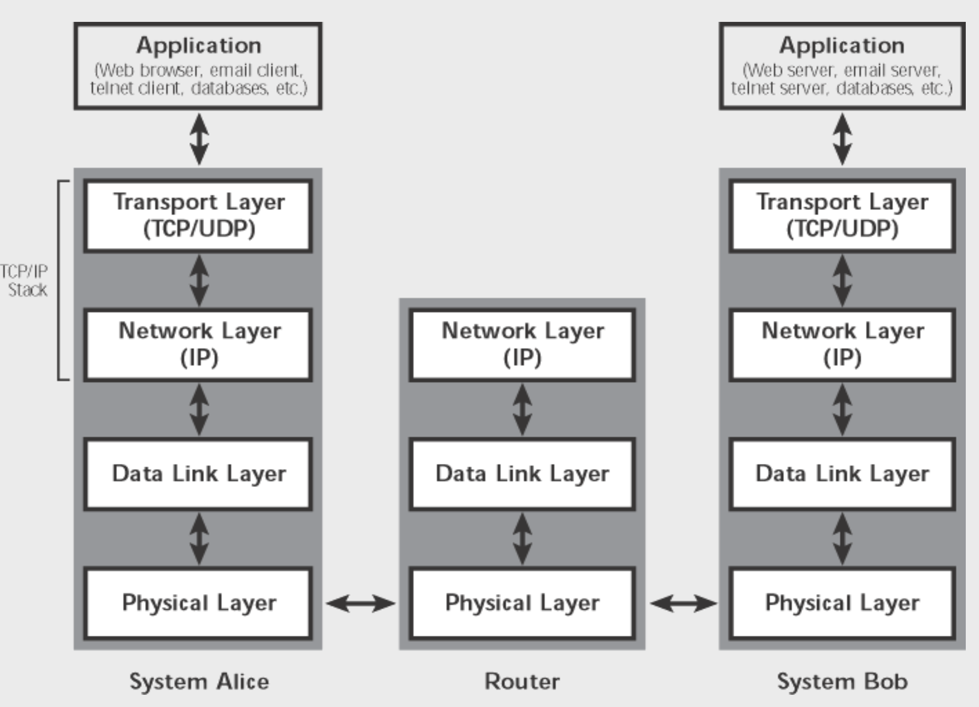
TCP/IP Protocol Stack

Slide 27
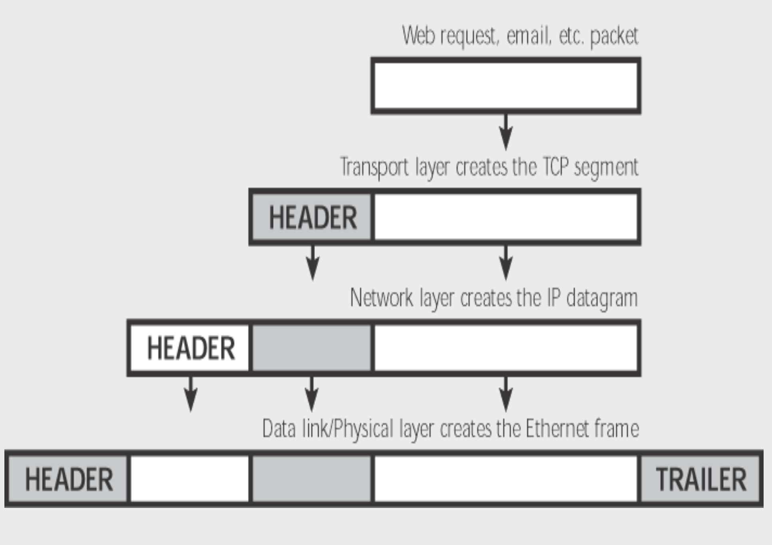
TCP/IP Encapsulation

Slide 28
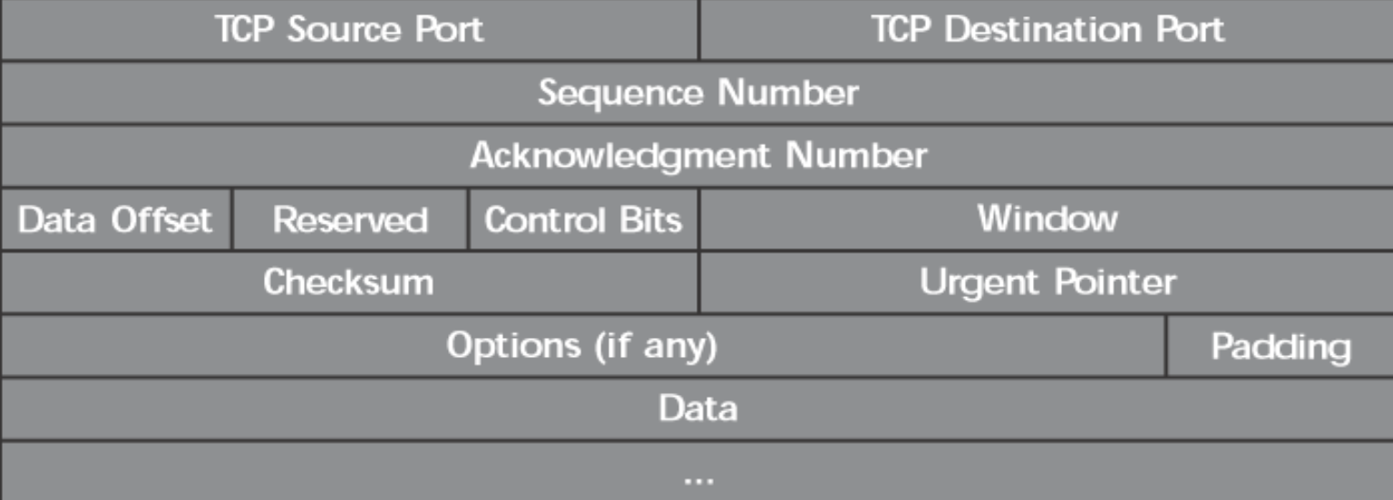
TCP Header

Slide 29
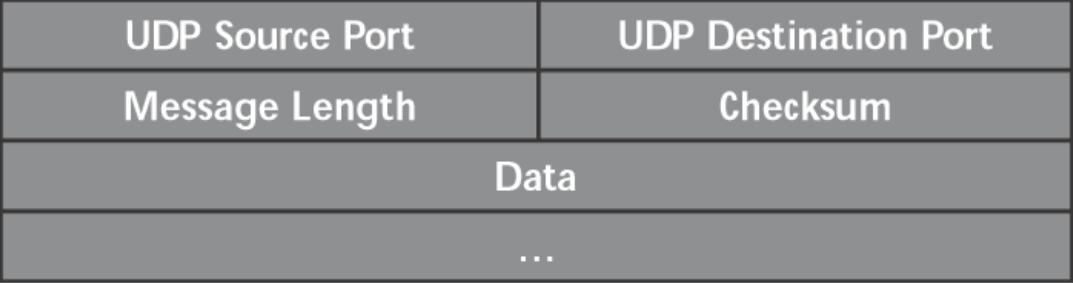
UDP Header

Slide 30
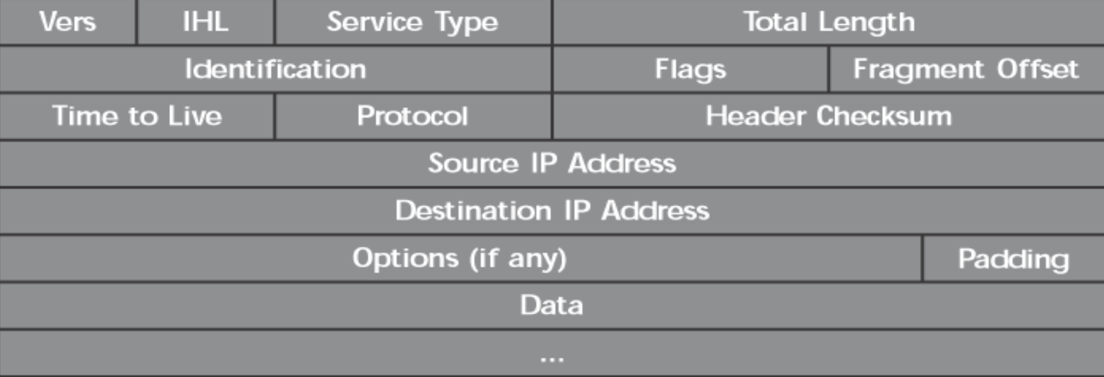
IP Header

Slide 31
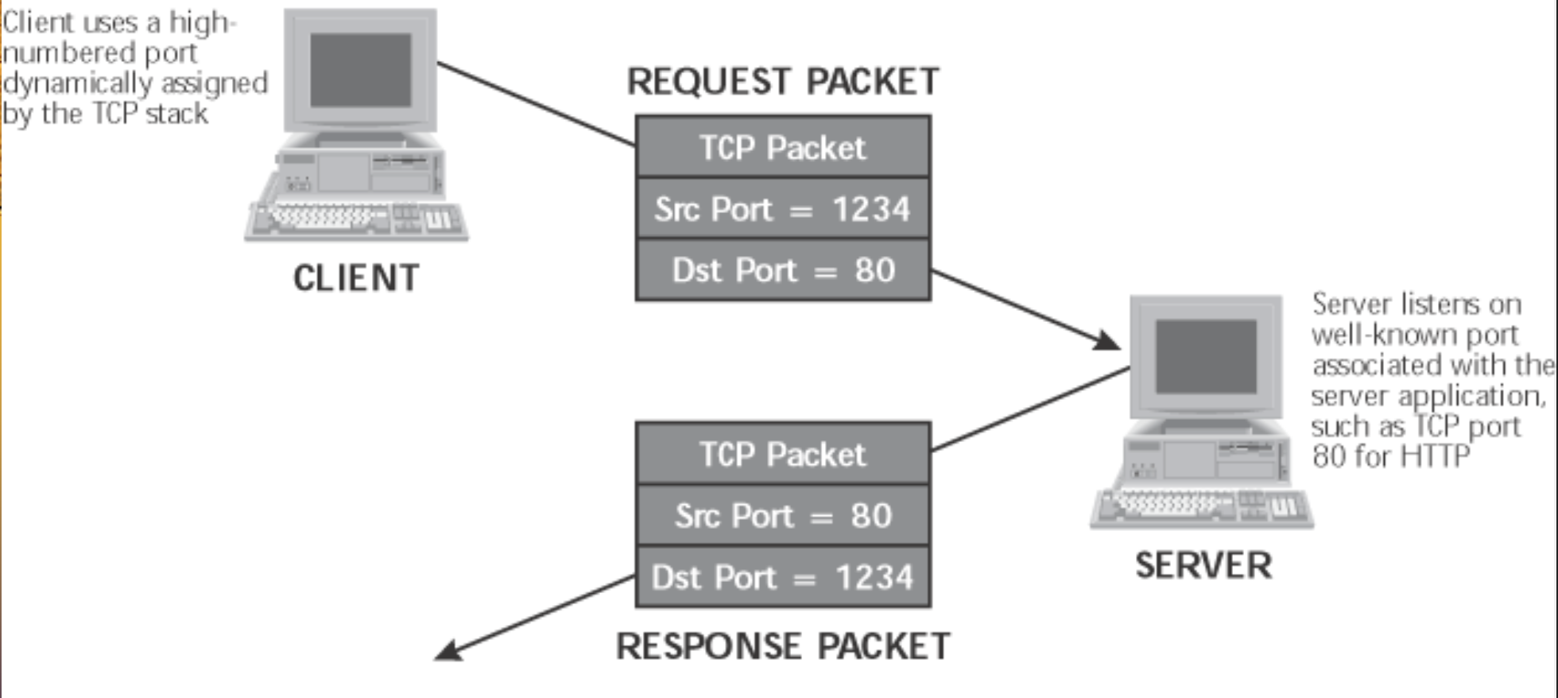
Packets in practice

Slide 32
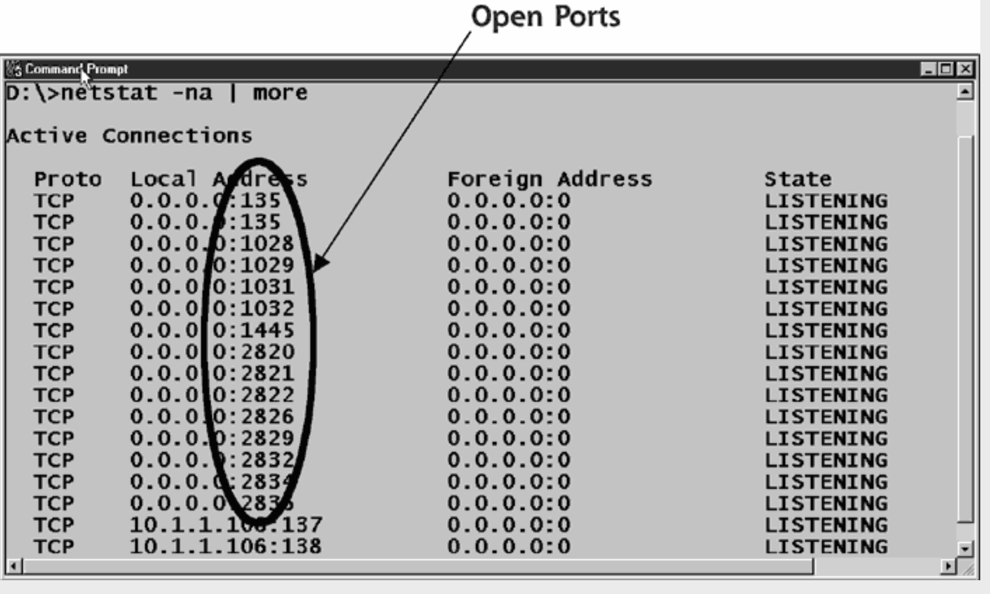
TCP Ports in practice

Slide 33

Break

Slide 34
Creating a Network
What makes a network?
Systems
Switch/Hub
Router
Firewall
Wireless Access Point
Proxy
IDS/IPS
Forensics Appliance
What’s it look like?

Slide 35
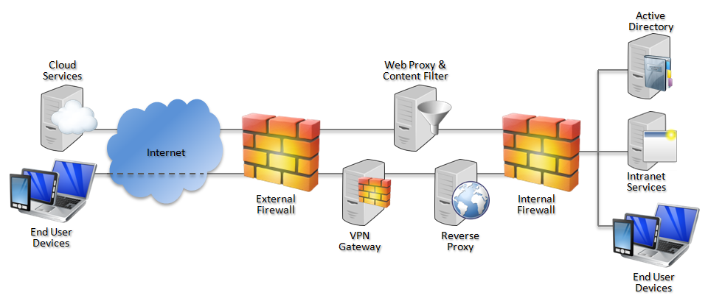
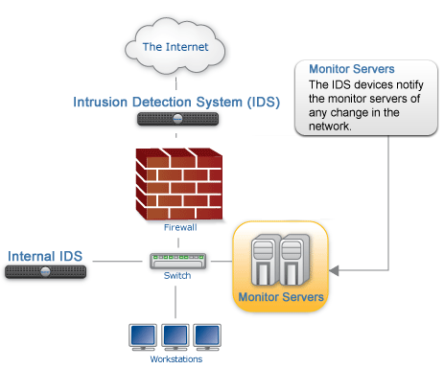
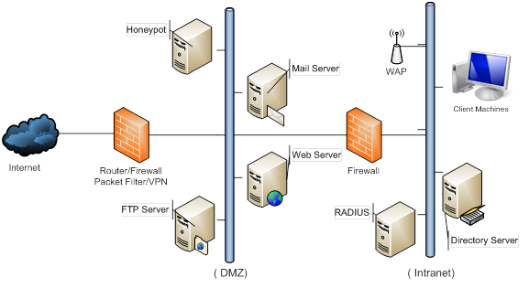
Creating a Network

Slide 36
Packet Analyzing/Sniffing
All data on a network that is transmitted can be sniffed.
Web pages
Copying of files
Mail flow
DNS lookup
Network cards need to be put in “promiscuous mode” in order to listen to everything going on within the network.
Can be set with a literal “flip of a switch” via software
Network architecture needs to allow for “chatty” systems
Every node within a single LAN segment can see traffic of others on that segment

Slide 37
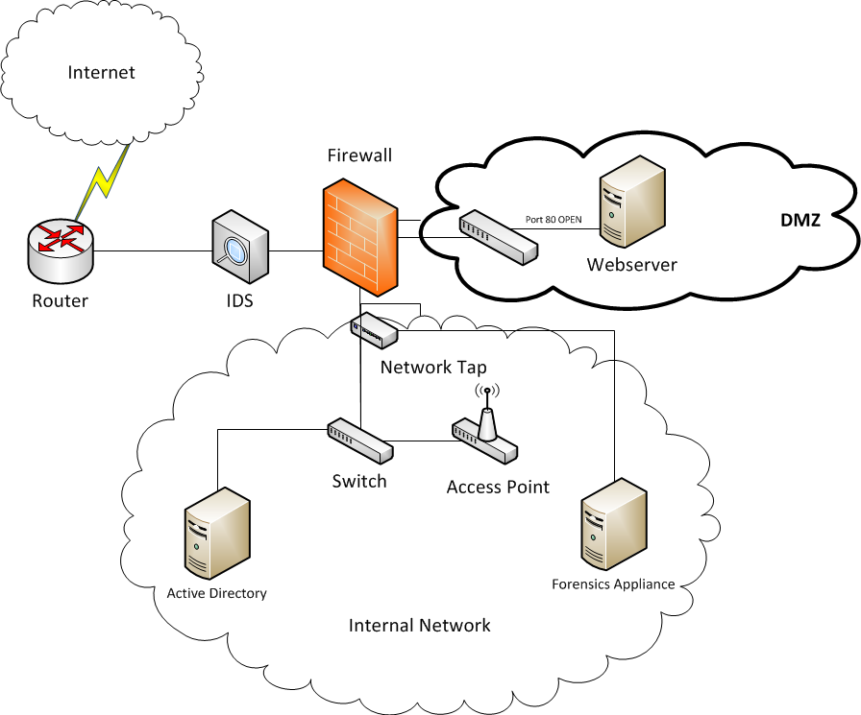
Packet Analyzing/Sniffing

Slide 38
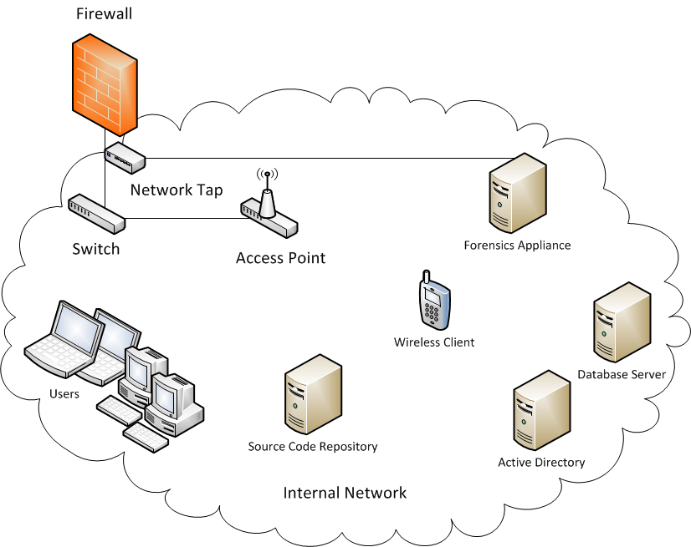
Packet Analyzing/Sniffing

Slide 39
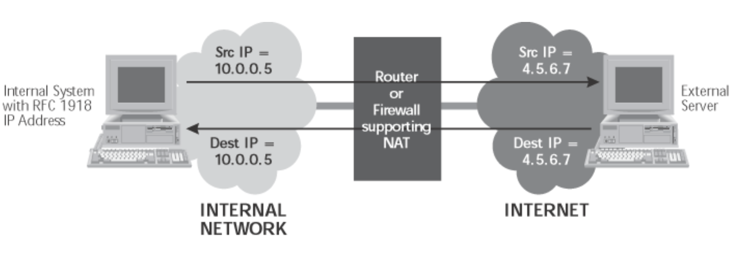
NAT and Sniffing

Slide 40
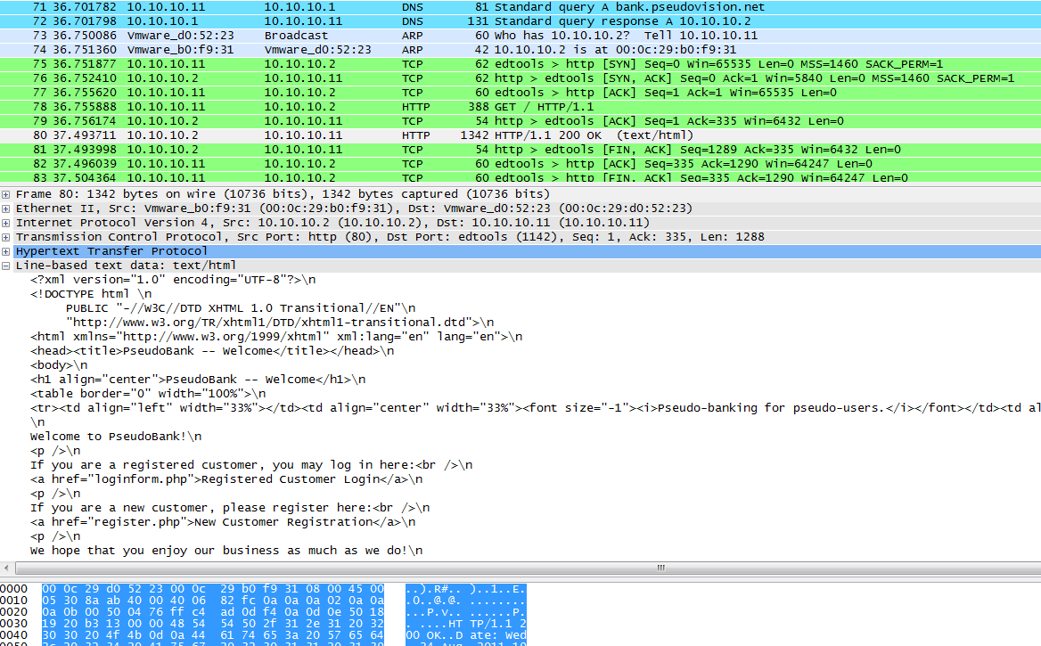
Packet Analyzing/Sniffing

Slide 41
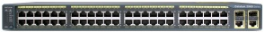
Sniffing Mitigation
By segmenting the Internal Network, you limit visibility of network sniffing, as well as provide a greater granularity of control over what access is needed.
Virtual Networking/VLAN allows for hosting multiple networks on a single network switch.
In order to sniff “ALL” VLANs, administrators set up a SPAN/Mirror port on the switch to plug into a network tap.
Does not prevent sniffing within a VLAN

Slide 42

Why Sniff?
Sniffing captures ALL data on the wire.
Sniffing is used to troubleshoot network issues as well as inspect traffic to ensure it is not malicious. This practice is used in conjunction with Network Forensics tools and Intrusion Detection systems.
All “clear text” protocols are potential threat vectors
Some “encrypted text” protocols are as well depending on the strength of the encryption
IM conversations
POP Mail
SMTP Mail
DNS lookups
HTTP traffic
VOIP
Streaming video/music

Slide 43
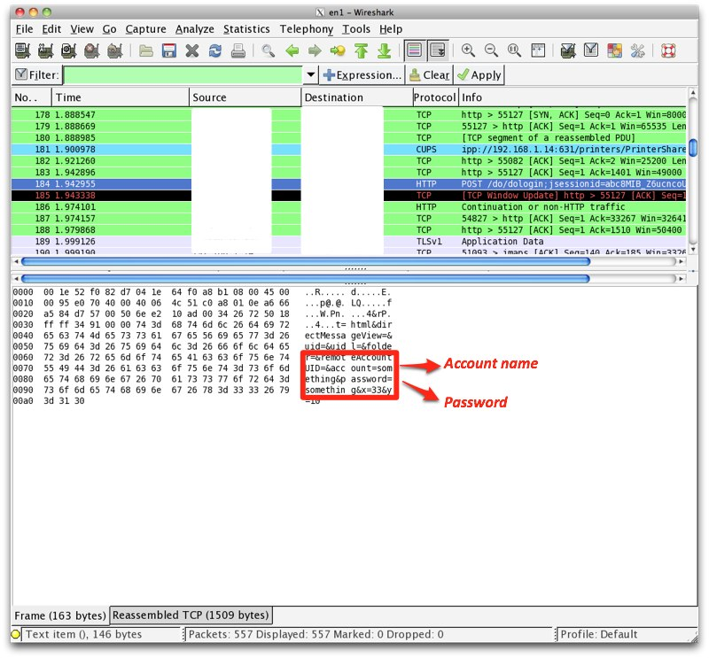
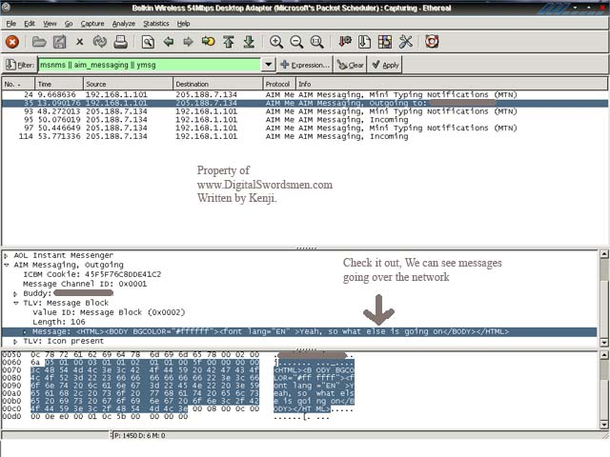
Why Sniff?

Slide 44
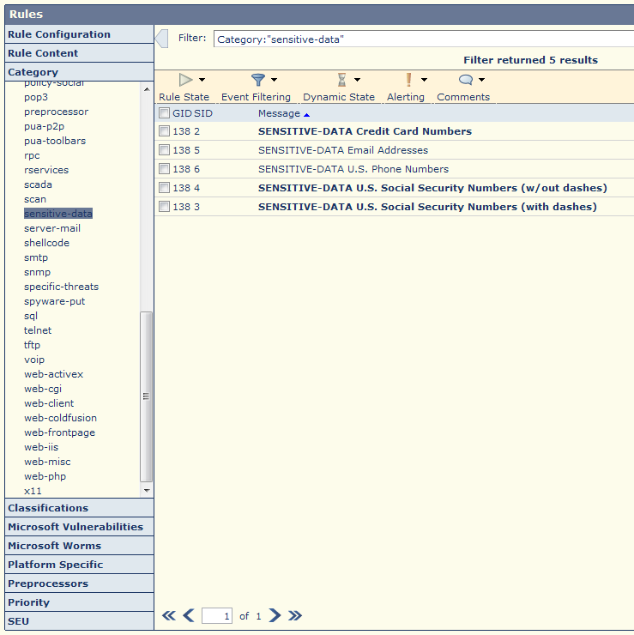
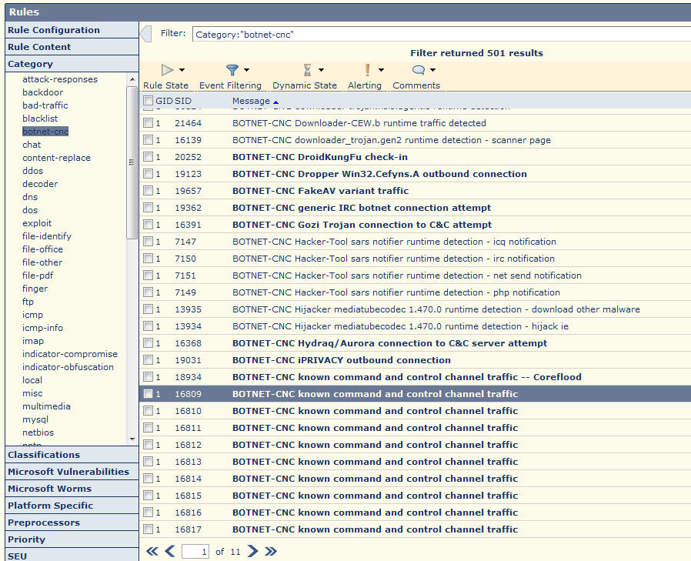
Why Sniff?

Slide 45
Summary
Know the six steps in the attacker’s methodology.
Explain the ethical hacker’s process.
Be familiar with the OSI model and each layer’s function.
Be familiar with the TCP/IP protocol stack.
Describe the four layers in the TCP/IP protocol.

